Slide 1
Scott Browning
CEO & Founder

Slide 2



Scott Browning
1990-2003
2004-2015
2016
Notes:
Scott has over 20 years of experience leading corporate marketing, sales and internal communications for multi billion-dollar companies across consumer discretionary industries in Australia & New Zealand. He was Marketing Director of JB Hi-Fi from 2004-2015 with responsibilities for brand strategy, store design & development, omni-channel, digital innovation and communications. Between 2004 and 2015 JB Hi-Fi grew from 25 Stores in Australia generating $500M in revenue to over 180 Stores across Australia & New Zealand with $3.7 Billion in annual revenue. Prior to JB Hi-Fi he held senior management sales & marketing roles with Eastman Kodak. He is currently founder and CEO of Quickar; A startup seeking to empower communities with access to low cost and sustainable private mobility solutions.

Slide 3
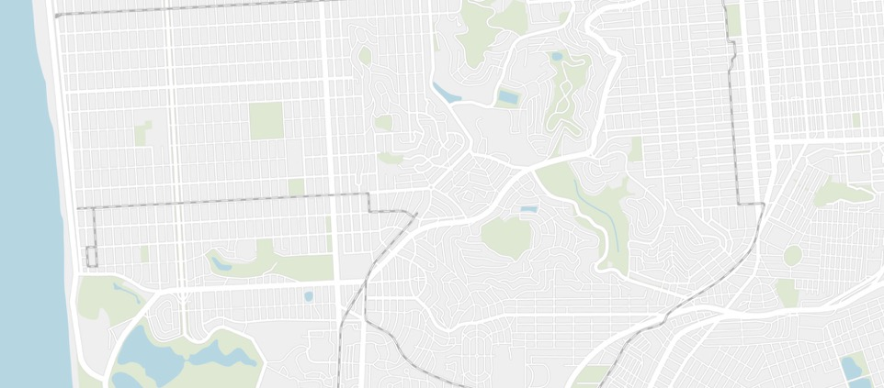

Carsharing (Station Based)
Round trip
You go to a station
You drive
You return car to station
B
A

Slide 4
Carsharing (Free Floating)
One way
You go to a car
You drive
You leave the car
B
A

Slide 5
Station vs Free-Floating
Return to Station
Planned Access
Pre-Chosen Duration
6-8 Hours per trip
Station Infrastructure
Find anywhere in Zone
Return anywhere in Zone
Spontanteous Access - 30Min Hold
20-30min per trip
Easy Deployment

Slide 6
Find it. Drive it. Drop it.
60 Sec Video

Slide 7
Seamless & Intuitive App UX
3 Clicks to be on the Road
Visualise all cars available for unregistered users
Registration
Fuel Status & Information
Book, put ‘on hold’, display timer
Radar Function for notifications
Walking itinerary and ETA display
Unlock/End Trip
Manage Account
Personal dashboards; trips, billing

Slide 8
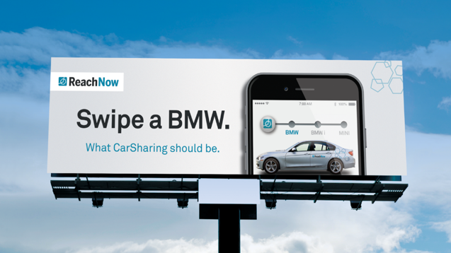
Car Sharing Revolution

Slide 9
Shared Mobility Eco-Sphere
80% Trips
TNC
(Taxis/Uber Etc)
Short-Term rental
Station based
Return
Free-Floating
or
One Way
Peer-to-peer
Carsharing
Bike and
Walking
Public Transport
(subway,bus,train,etc.)
Car pooling
& Dynamic Routing
Flexibility
Distance
<10Km
>10Km
Source: Inov360, 2015 / NSW Transport Household Travel Survey 2013

Slide 10


Competition – Private Mobility
Lower
Cost PER KM
1 Way
Sharing .
Station Based
Low Utilisation –
< 80 Km/8hrs per week
Ownership
Higher
Cost PER KM
Lower
Convenience
Higher
Convenience

Slide 11
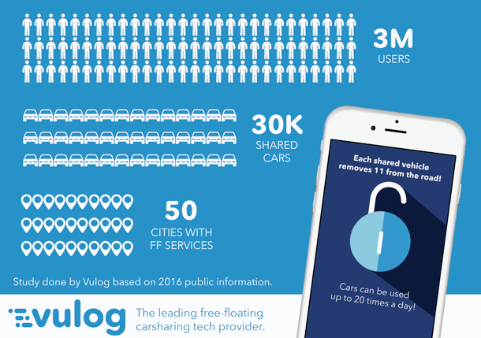
Free Floating Overview
Source: Vulog 2017

Slide 12
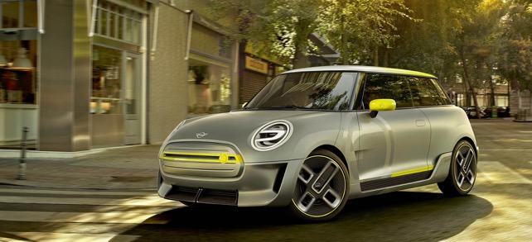
Free Floating Evolution
Electric Powertrain

Slide 13
Impact of Car Share on EV
Changes in Percent of Experimental Population Expecting to Purchase Various Vehicles After EV Car sharing Exposure

Slide 14
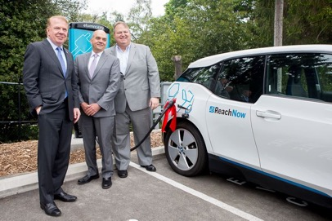
Seattle
20 stations and 100 chargers announced to serve 100+ ReachNow BEVs (May 2017)

Slide 15
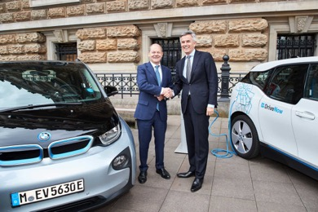
Hamburg
550+ BEVs with by 2019 with 250+ by end of 2017

Slide 16
Copenhagen
1000+ BEVs incorporated with Public Transport since 2015

Slide 17
Madrid
250+ BEVs with 100,000 users registered in 100 days in 2017

Slide 18
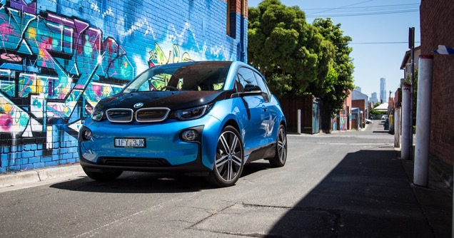
Melbourne
1000+ BEVs operating by 2026

