Slide 1
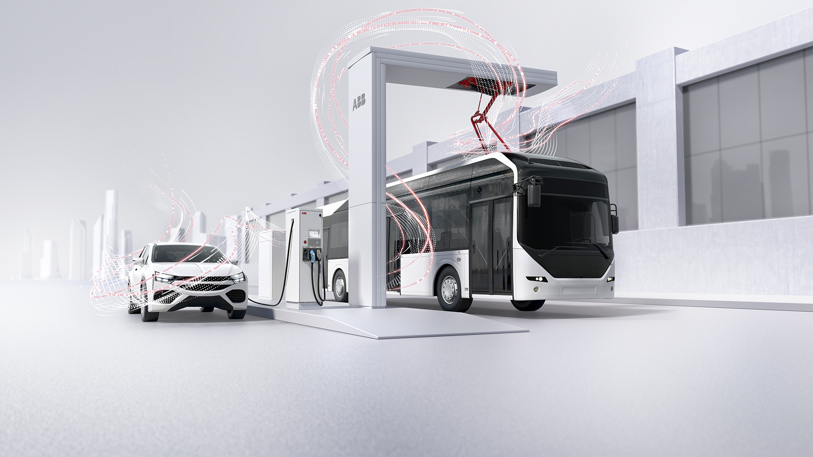
EV Infrastructure
November 13th, 2017 / Steven Dorresteijn / EP EVI
Company presentation

Slide 2
ABB: the pioneering technology leader
What
(Offering)
Pioneering technology
Products 58% | Systems 24% | Services & software 18%
For whom (Customers)
Utilities | Industry | Transport & Infrastructure
~35% of revenue | ~40% of revenue | ~25% of revenue
Where
(Geographies)
Globally
Asia, Middle East, Africa 38% | Americas 29% | Europe 33%
~$34 bn revenue
~100 countries
~132,000 employees

Slide 3




ABB in Australia
Revenue Dec 2016
$654 MAUD
Orders Dec 2016
$651 MAUD
Total workforce
1,350
Headquartered in Sydney with Sales offices and Service centres across Australia supporting all ABB systems and products
In Australia, global R&D and technical lead centres for Enterprise Software, Microgrids, Metal Enclosed Capacitor Banks, and Pole Mounted Switches
Manufactures LV systems, instrumentation systems and HV capacitors and power quality equipment, and Metal Enclosed Capacitor Banks

Slide 4

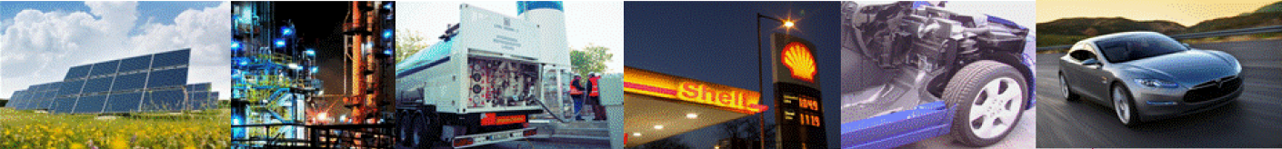
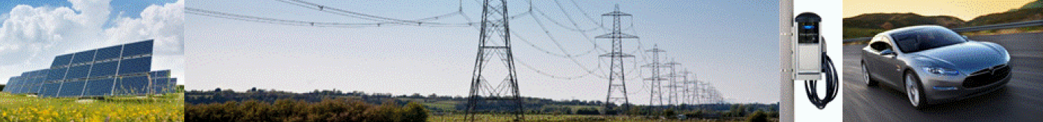
Well-to-wheel efficiency of alternative fuels
Range per year per m² of land
Biofuel: 7km
Most efficient energy crops (palm oil, sugar cane) deliver 0.5L/m² including sowing, fertilizing, harvesting, refinement and distribution.
A vehicle drives 15km/L, so 0.5L gives 7km range.
A solar panel delivers 105 kWh/m².
After electrolysis, compression and distribution 63kWh goes into the tank.
The fuel cell generates 31.5kWh of electricity.
The vehicle drives 5km/kWh, so 31.5kWh gives 160km range.
A solar panel delivers 105 kWh/m².
After distribution, charging and storage
in the battery, 77kWh is available to the motor.
An EV drives 5km/kWh, so 77kWh gives 380km range.
Hydrogen: 160km
Electric: 380km
Original source: Auke Hoekstra, Eindhoven University of Technology. Data was modified due to improved performance of biofuel and hydrogen.

Slide 5
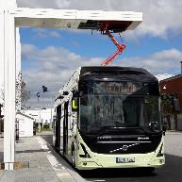
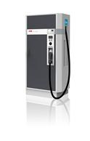








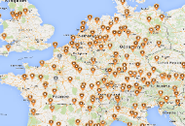

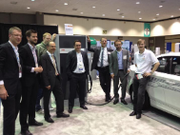
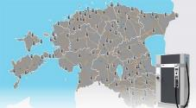

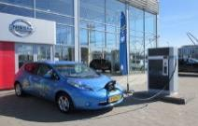
EV fast charging and global standardization
ABB leading in major developments this decade
  2016
  First eBus chargers in EU
  Global partnerships with bus OEMs
DC home
Higher power
  2013
  Launch CCS & multi-standard Terra 53
  CCS + CHAdeMO + AC
  2013-2015
  Launch global variants Terra 53
  China, USA, APAC
  2012
  Founding of CCS alliance
  ABB was involved from the start, basis for IEC standard
  2010
  Founding of CHAdeMO
  ABB was involved from the start
  2010
  Launch ABB Terra 51
  50 kW CHAdeMO charger
OppCharge
Near Future
E-bus
Global EV spread
Multi-standard
CCS alliance
IEC 61851-23
Pilots
CHAdeMO
First EV’s
  2014, >
  DC networks spread globally
  Europe, USA, Asia
  2012 - 2013
  First nationwide DC networks
  ABB in Estonia, Denmark, Netherlands
  2012, >
  Leading Connectivity & uptime
  ABB has industry leading uptime by remote management
  and supports global payment solutions
  2010
  First 50 kW charger in EU
  Based on proprietary standard, no consumer EV’s available
  2010
  First EV’s with DC charging
  Nissan Leaf & Mitsubishi iMieV
  2012
  First demo of CCS charging
  ABB & CCS alliance at EVS26 show In Los Angeles, USA

Slide 6


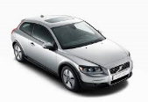
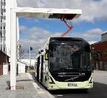
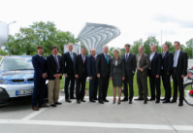
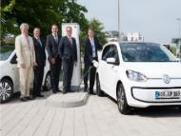
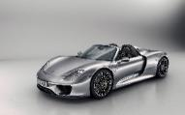
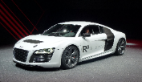
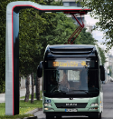
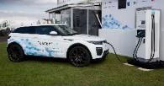





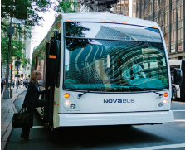




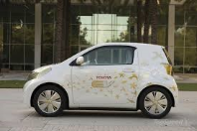

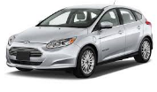


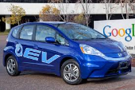





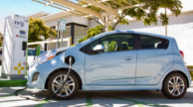
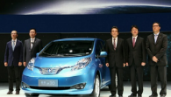
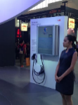





ABB is global charging partner for Car and Bus OEM’s
Strong presence in China, USA and Europe
-- R&D partners
- R&D partners
- DC Wallbox
- R&D partners
- DC fast chargers
at dealers
- Global partnership
- R&D partners
- R&D partners
- DC fast chargers
at dealers
- R&D partners
- DC fast chargers
at dealers
- R&D partners
- R&D partners
- R&D partners
- Partnership
- R&D partners
- R&D partners
- DC fast chargers at dealers
- R&D partners
- R&D partners
- DC fast chargers at dealers
- Cooperation Dong-Feng
- - DC charging testing & R&D
- R&D partners
- DC wall box for Denza EV
- DC charging testing & R&D
- R&D partners
- R&D partners
- R&D partners

Slide 7
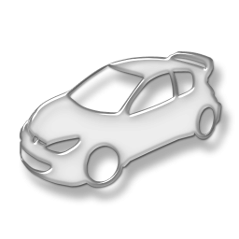
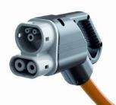

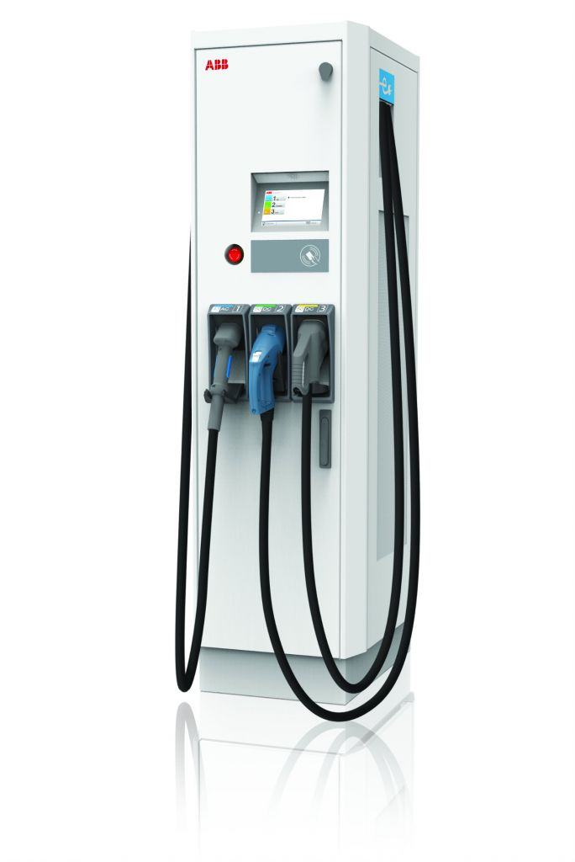

ABB ECVI
Partnerships with IBM and Microsoft
ABB EVCI
platform
Web tools
customer
ABB managed connectivity with extended protocol
Web tools
ABB service
ABB is global charging partner for Car and Bus OEM’s
ABB is a committee member of the charging Standards
ABB is a global leader in power conversion and control
Global Charging Partner
Standards Influencer
Technology Innovator

Slide 8

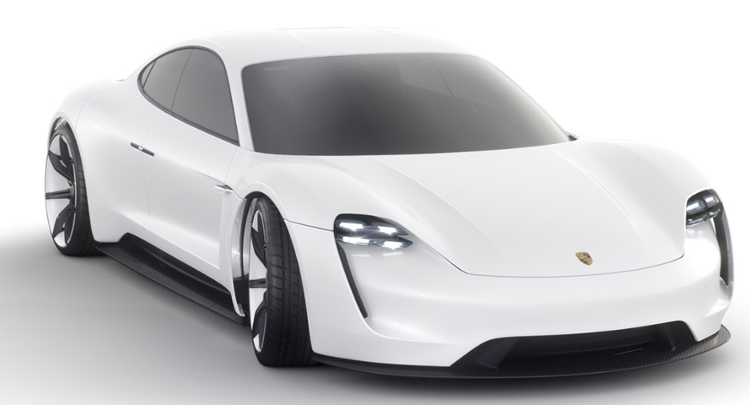
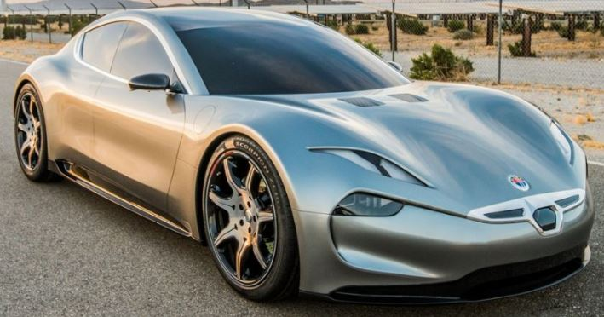
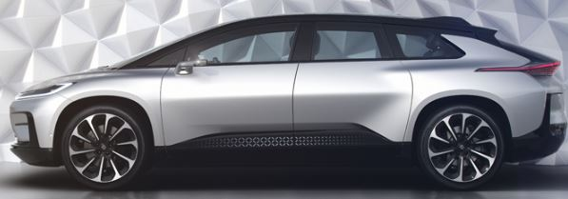
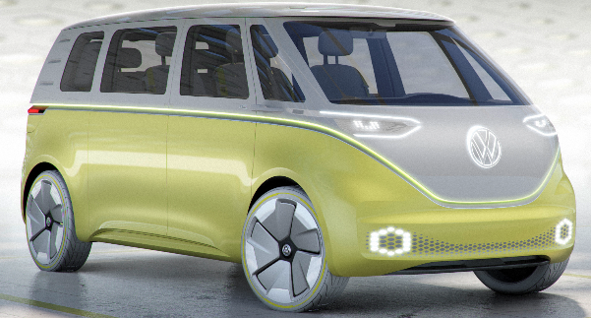
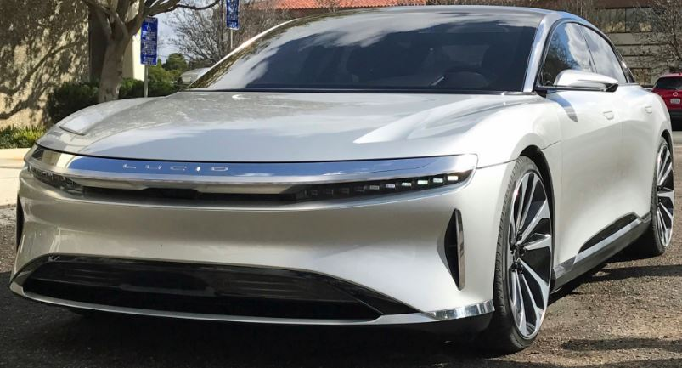
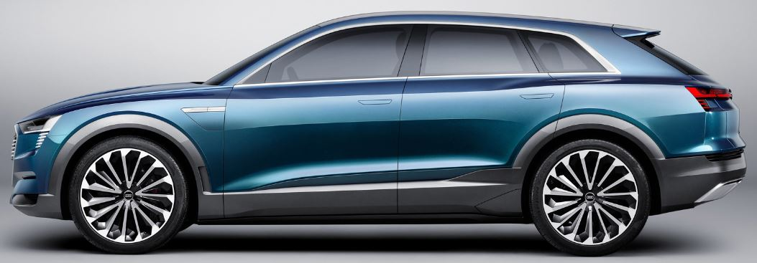
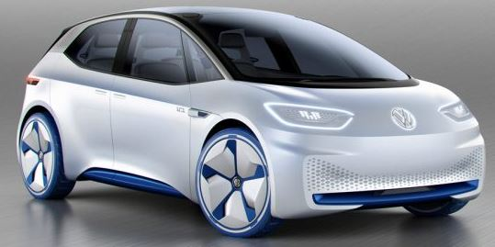
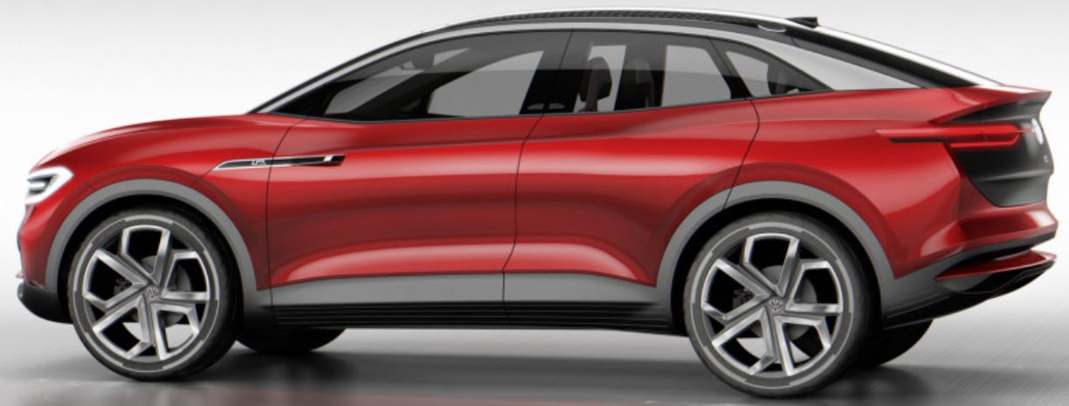
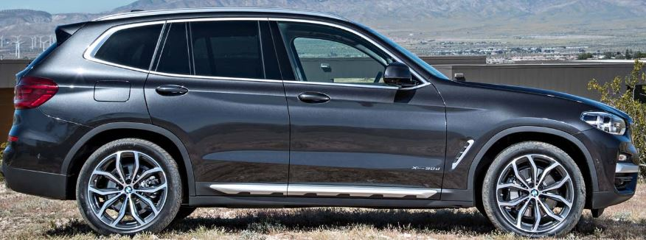
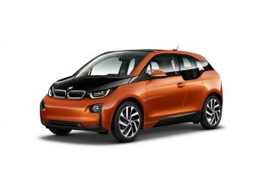
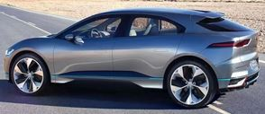
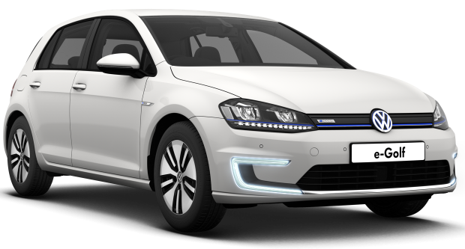
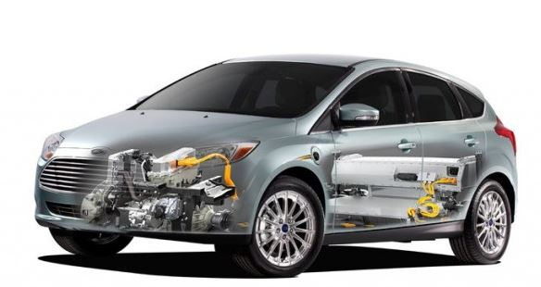

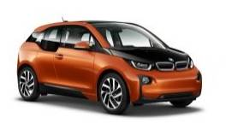


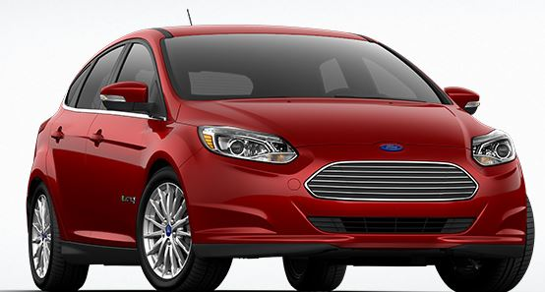

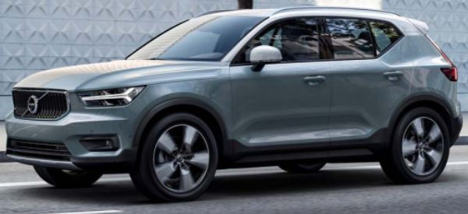
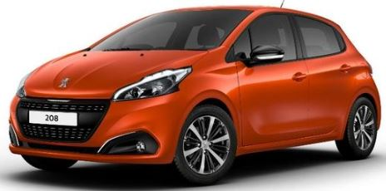
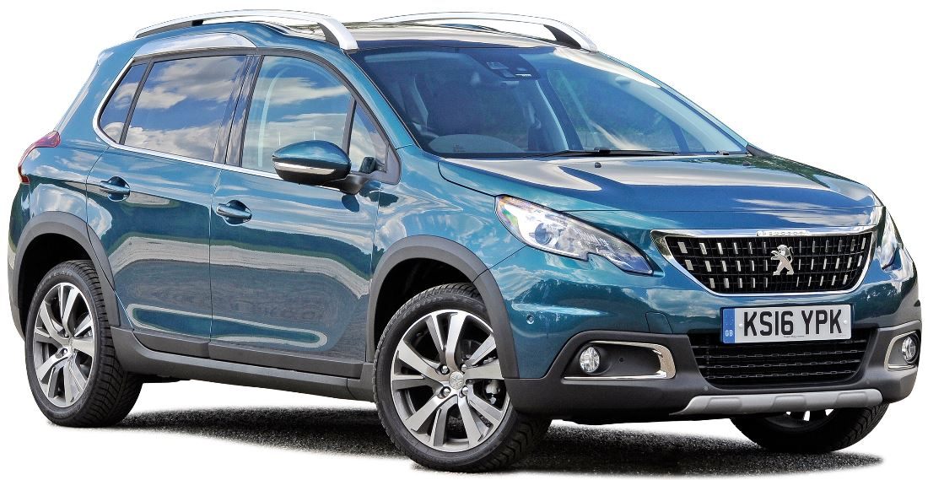
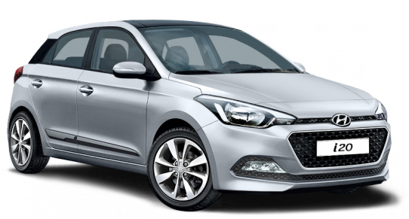
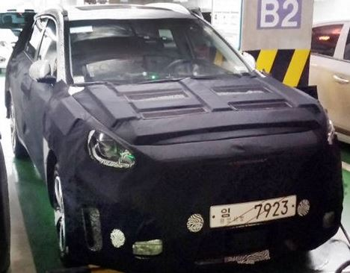
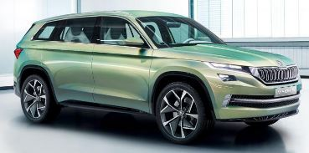
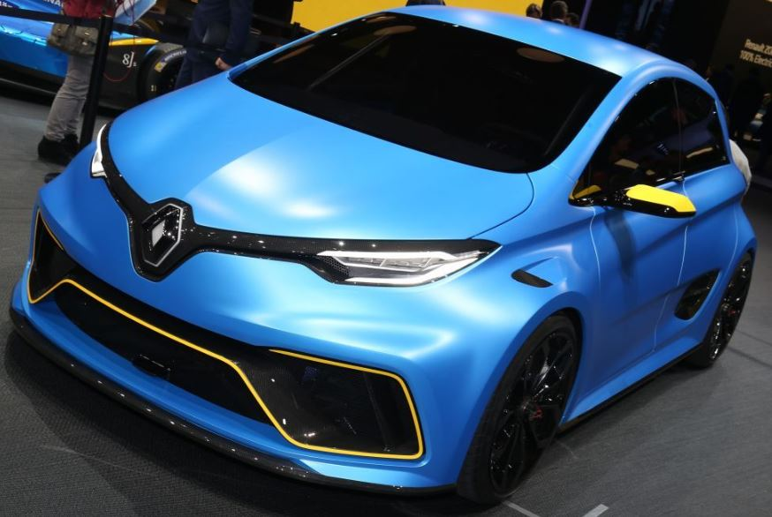
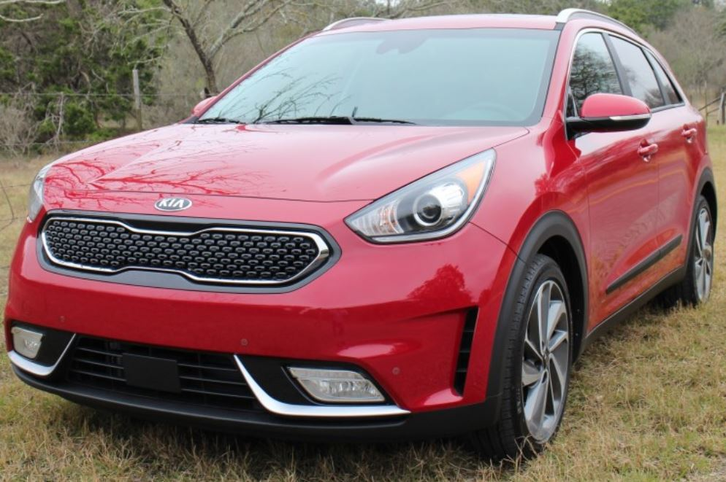



































Follow the car through Europe, and open standard protocols
2010 - 2016
2017
2018
2019
2020
2021, …
DC high-power charging CCS (≥350 kW @400/800 V)
450 km
Porsche Mission E
600 km
500 km
DC high-power charging CCS (≥150 kW @400 V)
650 km
FF 91
VW ID Buzz
Fisker Emotion
500 km
500 km?
?? km
500 km?
Lucid Air
650 km
Audi eTron (SUV)
?? km
?? km
VW ID 'Golf'
VW ID Crozz
BMW X3e
450 kmh
300 km
DC fast charging CCS (50 kW @400 V)
130 km
190 km
Jaguar i-Pace
VW e-Golf 1.1
?? km
Ford Model E
BMW Mini E
110 km
BMW i3
BMW i3
300 km
165 km
350 km
??? km
??? km
130 km
AstonMartin
RapidE
Opel Ampera-e
Focus Electric
Volvo XC40
Peugeot 208 EV
VW e-UP!
VW e-Golf
180 km
500 km?
?? km
Peugeot 2008 EV
140 km
320 km
Hyundai Ioniq
VW e-Golf
Hyundai eSUV
Skoda E
Renault Zoe
450 km
Kia Niro
150 km
500 km
??? km
450 km
?? km
DC fast charging
CHAdeMO
(50 kW @400 V)
110 km
110 km
350 km
120 km
130 km
Tesla Model X
(adapter)
Tesla Model 3
ccs?
Mercedes EQC
Mercedes EQA
Peugeot
Partner
Tesla +adapter
?? km
250 km?
Nissan Leaf 1.1
110 km
200 km
300 km
Nissan Leaf 1.0
Citroën C-Zero
40 km
150 km
Mazda EV
ccs?
Honda Urban
ccs?
110 km
110 km
Nissan Leaf
110 km
Mitsubishi
Outlander PHEV
Nissan e-NV200
200 km
Nissan Leaf
Peugeot iOn
Kia
Soul-EV
Mitsubishi i-MiEV
Citroën Berlingo
Infinity LE
AC fast charging 43 kW
130 km
Renault Zoe ZE
130 km
200 km
450 km
110 km
?? km
AC charging 22 kW
Tesla Model S
Renault Zoe 1.1
Daimler Smart ED
Renault Zoe
450 km
Daimler E-Smart
AC charging 11 kW
140 km
Mercedes B250E
Tesla Model S
Only AC slow
(3.6-7.2 kW)
110 km
Smart ED
Gen 1
Ford Focus
Electric
100 km
Renault
Kangoo ZE
Mahindra e20
Mercedes
Vito E-cell
Renault
Fluence ZE
Renault
Twizy
200 km
Honda Fit
Citroën E-Mehari

Slide 9



Public and commercial car charging – use cases
Charging service should match charging application and demand
Public and commercial EV Charging
AC destination
DC destination
DC Fast
DC High Power
3-22 kW
20-25 kW
50 KW
150 to 350kW+
4-16 hours
1-3 hours
20-90 min
10-20 min
Office, workplace
Multi family housing
Hotel and hospitality
Overnight fleet
Supplement at DC charging sites for PHEVs
Office, workplace
Multi family housing
Hotel and hospitality
Parking structures
Dealerships
Urban fleets
Public or private campus
Sensitive grid applications
Retail, grocery, mall, big box, restaurant
High turnover parking
Convenience fueling stations
Highway truck stops and travel plazas
OEM R&D
Highway corridor travel
Metro ‘charge and go’
Highway rest stops
Petrol station area’s
City ring service stations
OEM R&D
February 13, 2018

Slide 10




Public and commercial car charging – use cases
Charging service should match charging application and demand
Public and commercial EV Charging
AC destination
DC destination
DC Fast
DC High Power
3-22 kW
20-25 kW
50 KW
150 to 350kW+
4-16 hours
1-3 hours
20-90 min
10-20 min
More information will follow in a later stage
Expected availability Q2-2018
February 13, 2018

Slide 11














Multi-standard charger solution Terra 53 & Terra 23
General explanation of naming convention
AC
CCS
CHAdeMO
Terra 53 (50kW) C - (Combo) = Combined Charging Systems (CCS) - DC
Terra 23 (20kW) J - (Japan) = CHAdeMO - DC
Z - (China) = GB - DC
T - (Socket) = Type 2 Socket - AC
G - (Grid) = Cable + Type 2 Connector - AC

Slide 12
Terra HP Series: 350 kW dual output
Ultra high output current & ABB’s unique Dynamic DC feature
Ultra high output current
375 A per 175 kW cabinet
2 x 500 A dual configuration
Can charge cars with both 400 VDC & 800 VDC drivetrain at maximum power
Dynamic DC feature
Dynamic DC power allocation delivers power dynamically to multiple outputs
Create a multi-output charging site in a highly cost-efficient way
350 kW
500 A
150-920 VDC
350 kW
500 A
150-920 VDC

Slide 13


eBus and heavy vehicle charging: 50 kW – 600 kW
Overnight and on-street opportunity charging
Automated connection system
High power DC transfer to bus
Wireless communication to bus
Based on
  EN/IEC 61851-23
  ISO/IEC 15118
  compatible
Industrial quality power cabinet
150kW, 300kW, 450 & 600 kW modular
Redundancy per each 150kW module
200-920 VDC
Galvanic isolation
Remote management

Slide 14

Connected Services
Connectivity is needed to:
Monitor and operate a network of chargers
Get paid for a charge session
Help EV-drivers in case of questions
Maintain and service a charger at lowest cost
Reliable 24/7 connectivity is fundamental for a commercial operation of a network of chargers!

Slide 15










Platform based integration of an ABB EV charger
Enabling you to face the dynamic challenges of the industry
Grid-side
Functionality
Demand response
Distribution system management
Using alternative energy sources
Integration with APIs &
advanced web tools
Authentication and billing
Subscriber management
Operational B2C services
Hardware and software checks
Charger management
Charger maintenance
Consumer Functionality
Charger
Management
Functionality
Notes:
Illustrating areas that influence the operation of an EV charging network.
All areas have different information interest and even more important… all three areas are still exposed to disruptive changes.
B2C:
roaming between platforms
Plug n charge
Charger management:
High power charging with 150kW, water cooled cables, 1000 V
Grid Side
- Just started… more and more questions from Enterprise mgmt. SW how to integrate EV chargers into SCADA systems etc
This can’t be handled locally at the charger. There is need for a platform. Therefore we have implemented a cloud solution
Cloud solution is a platform that uses open API’s (preferred to use standards)

Slide 16













ABB offers solutions for the complete value chain
From power generation to the vehicle
Power Quality/Conditioning
PQF, PCS100
DC Fast Chargers
Terra systems
Energy storage
B.E.S.S.
Grid Automation
SCADA & Ventyx
ABB’s solutions will work together seamlessly throughout the whole value chain
E-bus chargers
HVC 150
Charging Network Software Services
Connected services
Building Automation
KNX, energy mngt.
Components
DIN rail & distribution boards
Renewable Integration
HVDC, solar, wind

Slide 17


