Slide 1
EV support examples: Australia & overseas
Part of AEVA presentation to:
STANDING COMMITTEE ON ECONOMY AND INFRASTRUCTURE
Parliamentary Inquiry into Electric Vehicles

Slide 2
City of Adelaide support

Slide 3
WA: AEVA and RAC support
Reference: http://www.abc.net.au/news/2015-06-22/electric-highway-links-ev-drivers-from-perth-to-the-south-west/6565378

Slide 4
NSW: NRMA & EVC support

Slide 5
Queensland Government: EV charging network support Reference: https://www.qld.gov.au/transport/projects/electricvehicles/map

Slide 6
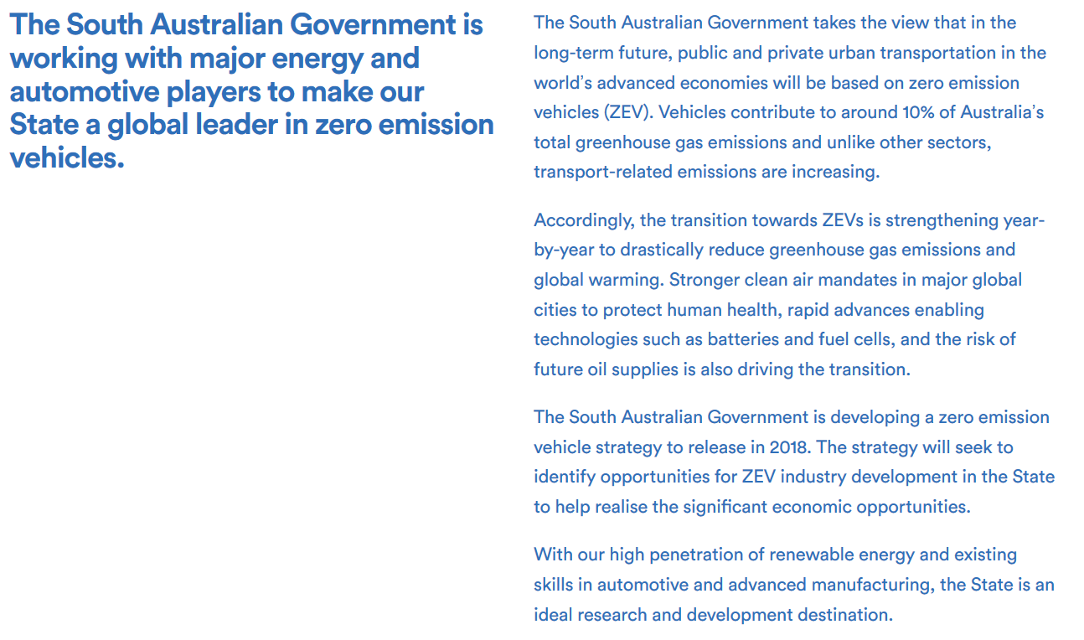
South Australian government: EV support
PLUS: Major EV related announcement due this Friday (16.2.18)
Reference: http://www.renewablessa.sa.gov.au/topic/zero-emission-vehicles

Slide 7
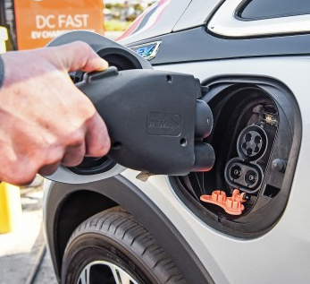
Charging plugs and standards are settled
Reference: https://www.fcai.com.au/news/publication/index/year/all/month/all/publication/99

Slide 8
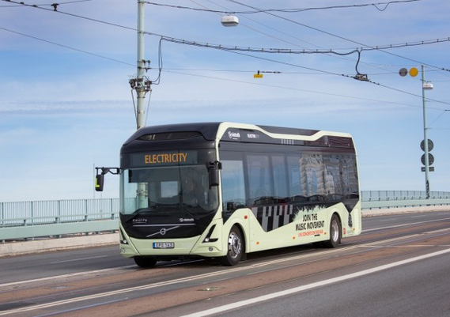
12 cities will buy only electric buses from 2025 - more expected to join
Mayors of London, Paris, Los Angeles, Copenhagen, Barcelona, Quito, Vancouver, Mexico City, Milan, Seattle, Auckland, and Cape Town all signed the C40 Fossil-Fuel-Free Streets Declaration, which pledges that they will add only fully electric buses to their cities' public transportation from 2025.
Note:
Each also pledged to “ensure that a major
area of their city is zero emission by 2030”
References:
Green Car Reports: November 14, 2017;
C40 cities: http://www.c40.org/other/fossil-fuel-free-streets-declaration

Slide 9
Internal Combustion Engine (ICE) era is ending:
Countries with legislated or planning sales bans of new ICE vehicles:
Norway: 2025
Holland: 2025 (2030 for ICE registration renewals)
India: 2030
France: 2040
England: 2040
California: legislation for 2040 just introduced to legislature
China: (Now world’s biggest vehicle market)
- 20% EV by 2025; date for total end to be announced

Slide 10
Addendum: EV vs ICE emissions for 10000 km, well to wheel, 2017
Reference: ReNew Edition 143 April – June 2018 (in production)

Slide 11
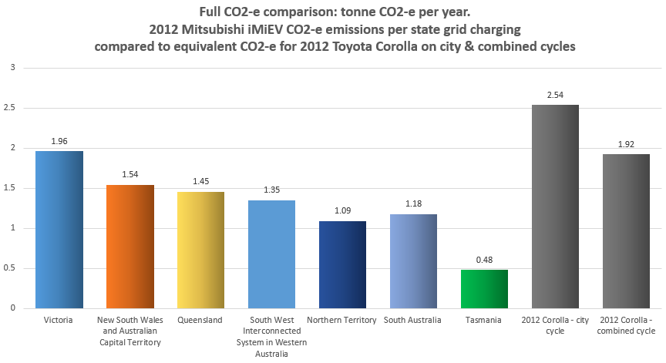
Addendum: EV vs ICE emissions for 10000 km, well to wheel, 2012
Reference: ReNew Edition 143 April – June 2018 (in production)

Slide 12
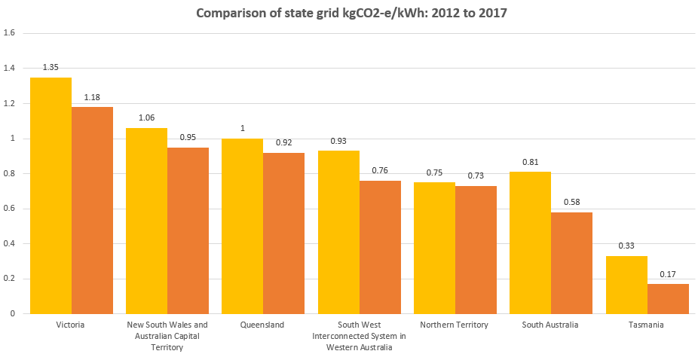
Addendum: Full grid CO2-e for each state, 2017 vs 2017
Reference: ReNew Edition 143 April – June 2018 (in production)

