Slide 1
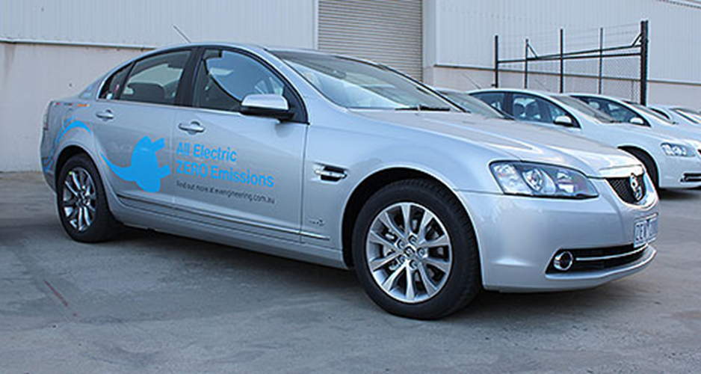
Petrol vs. EV
A comparative energy consumption and cost study
February 2012

Slide 2
CO₂ emissions per km
Current Vic. 1080 g/kWh
Current National Average (2017) 820 g/kWh
Estimated 2020 National Average 663 g/kWh
Petrol includes 7.6% upstream emissions factor (NGA)

Slide 3
Energy cost per km
Petrol high price 144 c/l
Petrol low price 117. c/l
Electricity high price 26.63 c/kWh (domestic peak 2017)
Electricity low price 12.77 c/kWh (domestic off-peak 2017)
*Petrol prices based on Australian Institute of Petroleum over the last 6 months

Slide 4
Payback time vs. annual driving distance

Slide 5
The grid is only getting greener

Slide 6
Supporting Information

Slide 7
Study objectives
What are the real-world operating cost and emissions differences between an electric and petrol-powered vehicle?
How is this affected by driving conditions?

Slide 8
Comparison methodology
Cars
MY 13 Holden Calais 3.6L V6
MY 12 EV Engineering Calais
Driving conditions
Mixture of urban, city and freeway driving
Non trained drivers
Climate control off
Energy Consumption Method
Petrol – On board trip computer
Electric – Revenue grade electricity meter

Slide 9
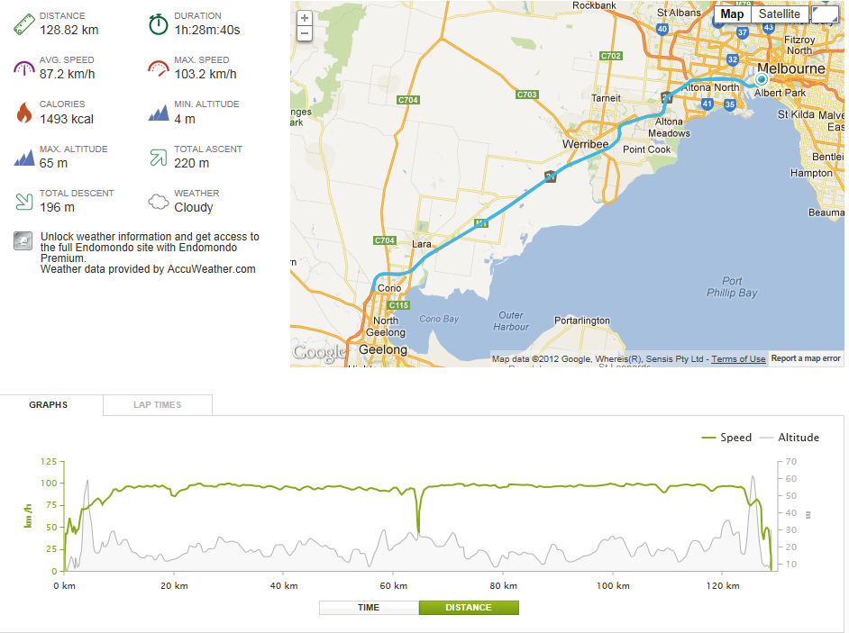
Test Routes - freeway

Slide 10
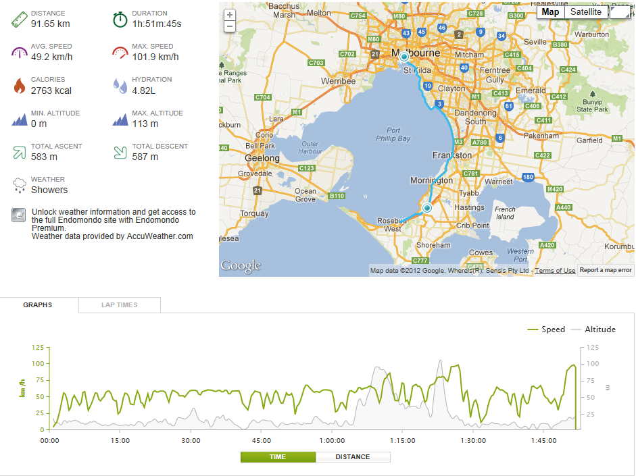
Test Routes – free urban road

Slide 11
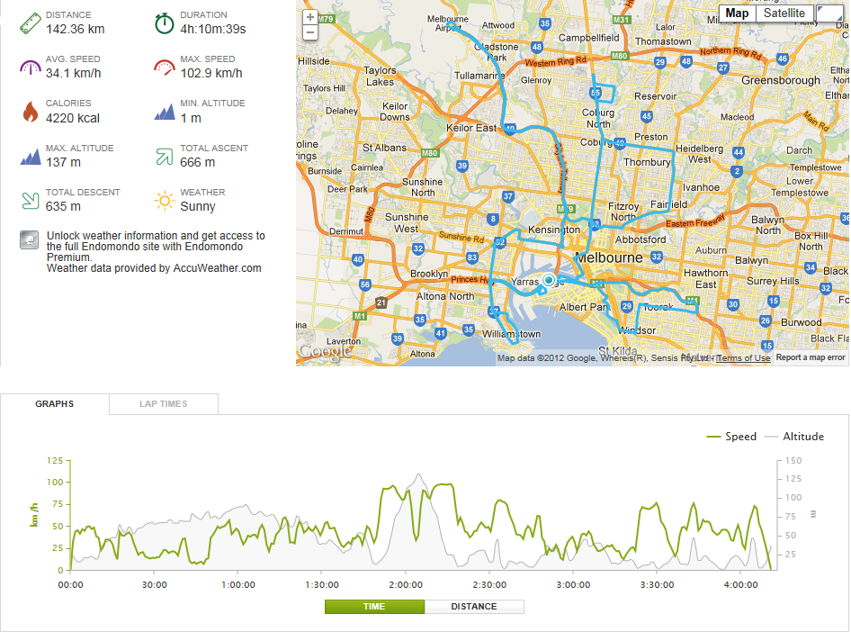
Test Routes – City Taxi

Slide 12
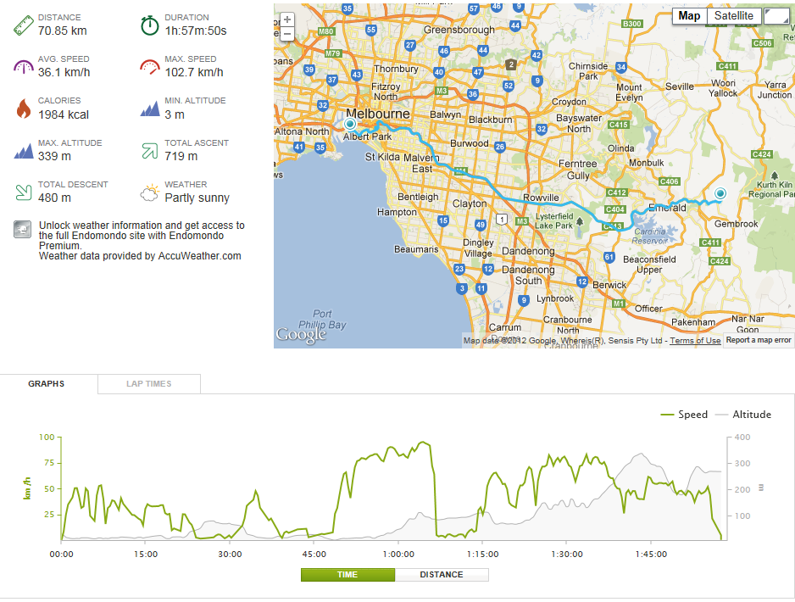
Test Routes – Country Gents Commute

Slide 13
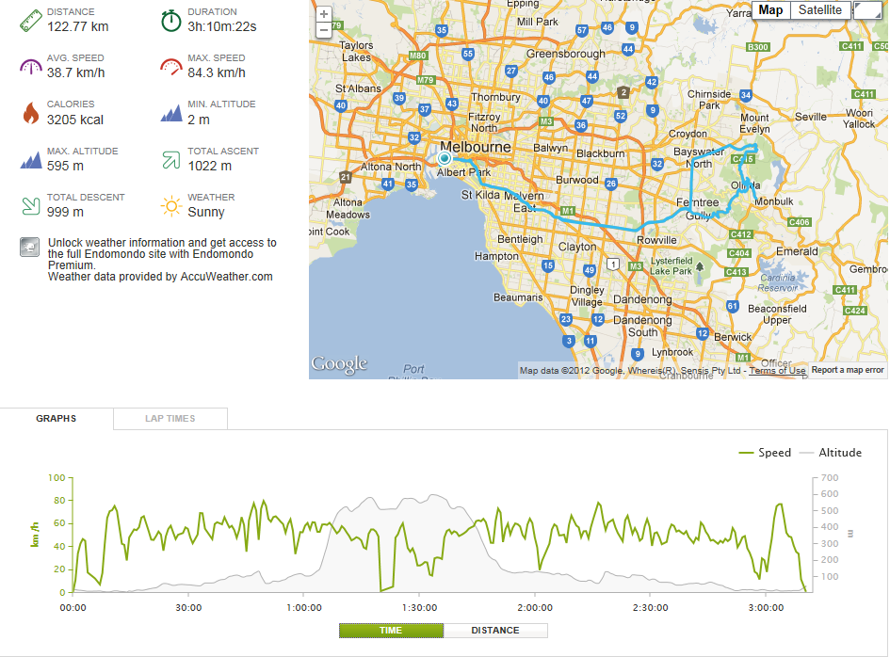
Test Routes – Scenic Drive/Hill Climb

Slide 14
Trip summary
Journey | Start ODO | End ODO | GPS Distance Travelled | Average Speed | Trip Time (hrs) | Max Elevation | Start SOC | End SOC | % of Battery Used
Freeway | 3219 | 3343 | 128.8 | 87.2 | 1.5 | 65 | 92% | 13% | 79%
Free urban road | 3343 | 3499 | 160.0 | 49.2 | 3.3 | 113 | 92% | 18% | 74%
Taxi Run | 3500 | 3638 | 142.4 | 34.1 | 4.2 | 137 | 91% | 13% | 78%
Country gents commute | 3640 | 3776 | 139.7 | 41.9 | 3.3 | 331 | 91% | 18% | 73%
Hill Climb | 3776 | 3897 | 122.8 | 38.7 | 3.2 | 595 | 89% | 20% | 69%
Combined |  |  | 693.6

