Slide 1
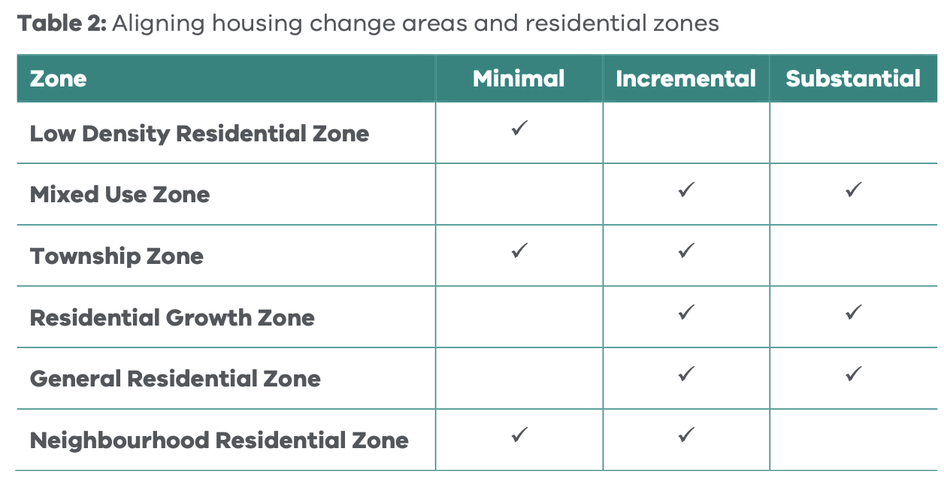
Changes to medium density housing provisions (Amendment VC267)
A combination of changes at once:
Changing standards to deemed to comply (a process started in 2023).
Making many standards more permissive.
Removing the general neighbourhood character objective / standard.
Removing ability to consider local policies when standard compliant / limiting application of policy.
Removing customization of local zones.
Removing the general cl 65 discretion.
Removing review rights.
This has been done without careful review of the existing standards, or of the underlying application of zones.
Removal of community appeal rights, if pursued, should follow careful testing and consultation.
ResCode 2000: Part 1 Report (Advisory Committee Report, 20 December 2000)
Planning Practice Note 91: Applying the Residential Zones

Slide 2
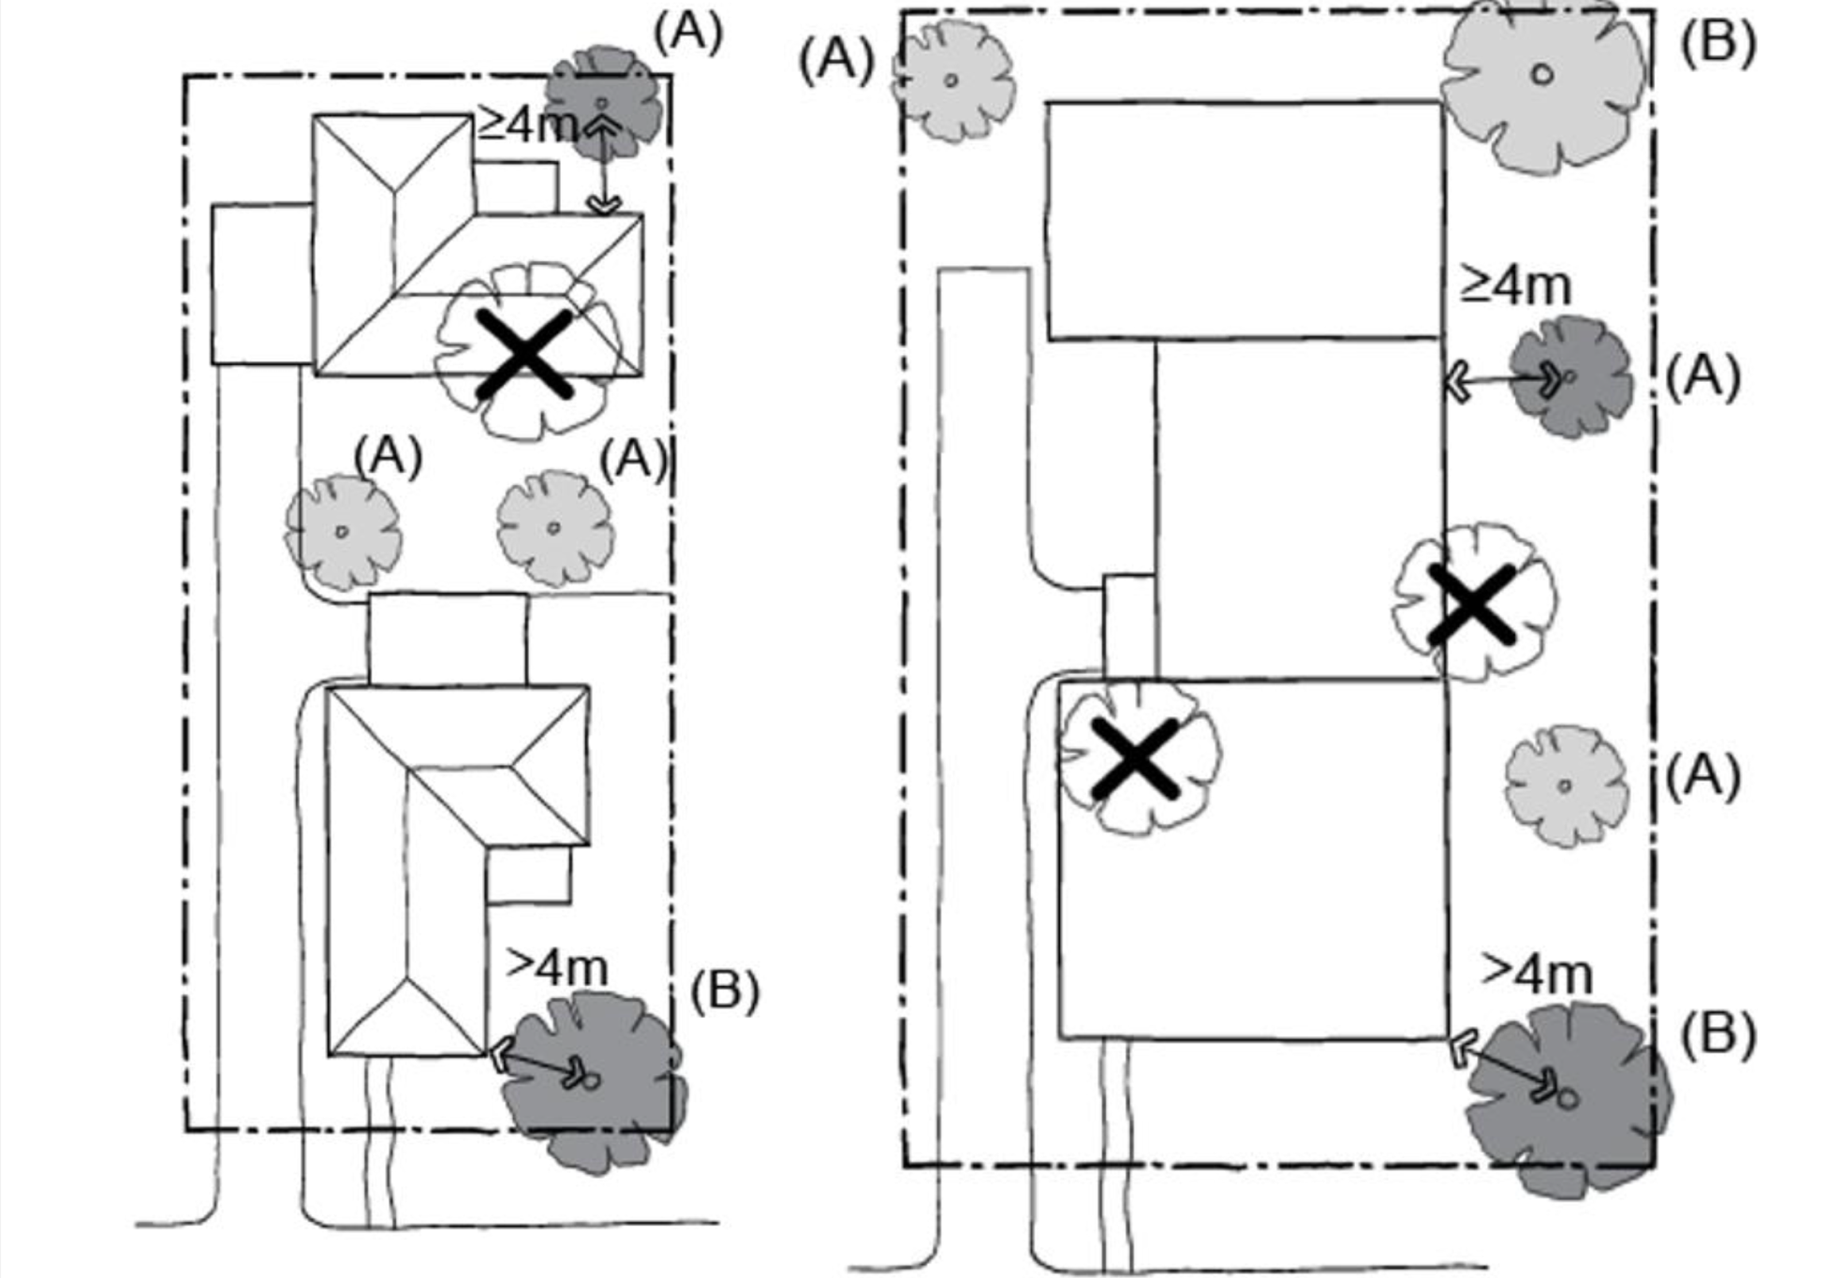
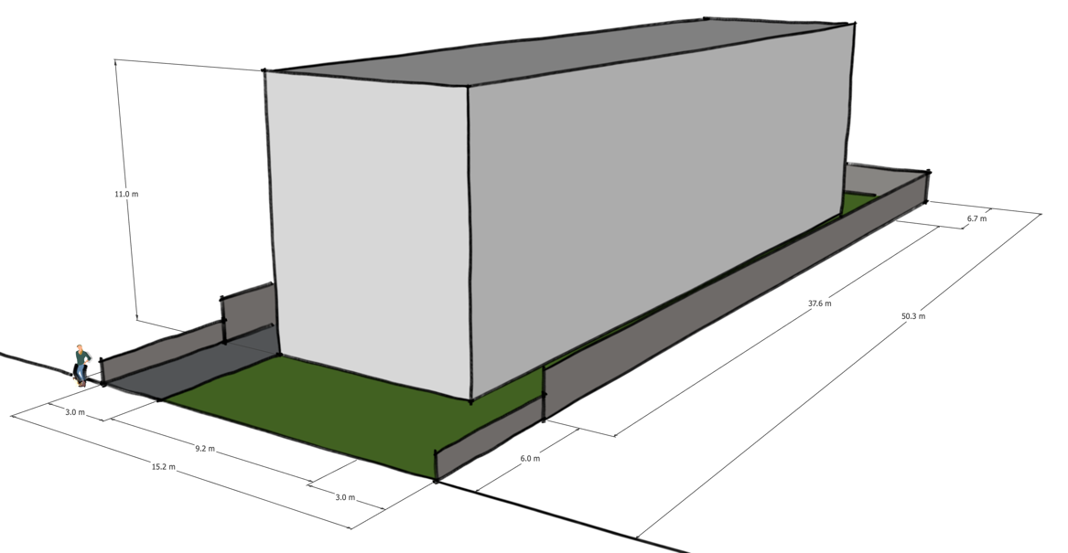
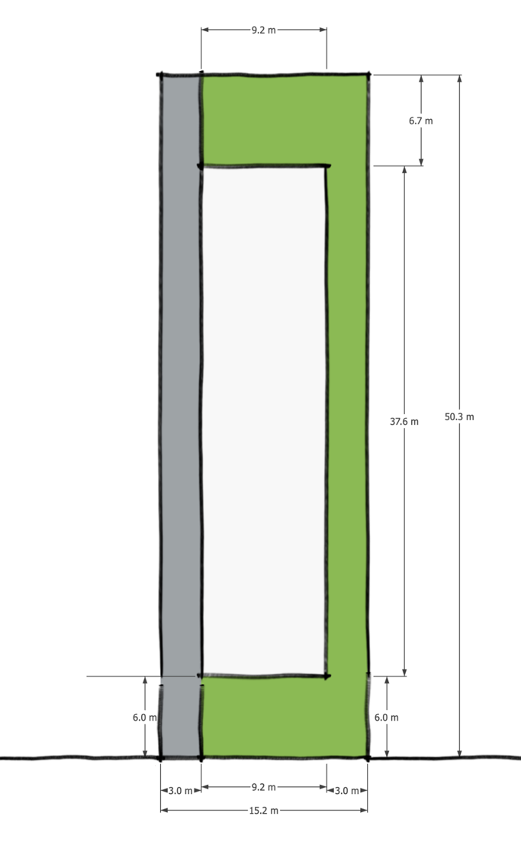
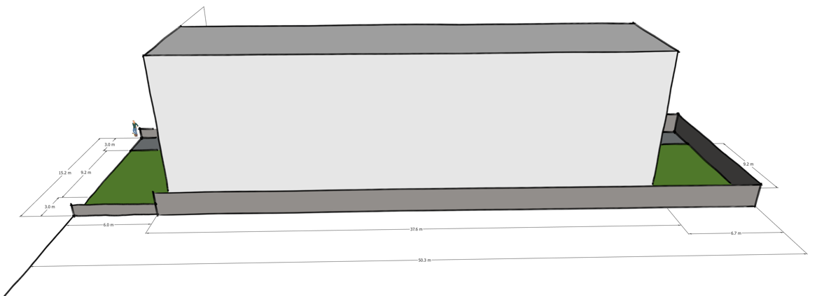
Outcomes
The best target for deemed-to-comply provisions is simple, low-risk proposals.
That said, in-principle it could be done (and has been done in the past). But this would require careful design of new form-based provisions.
Should start with a massing diagram, codify that, and test for workability and outcomes in a variety of situations.
An example of concerns: very low tree canopy obligations. No ability to ask for more landscaping.
Likely to lead to “moonscaping.”
Townhouse and Low-Rise Codes Guidelines

Slide 3
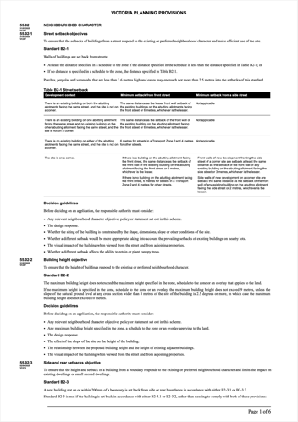
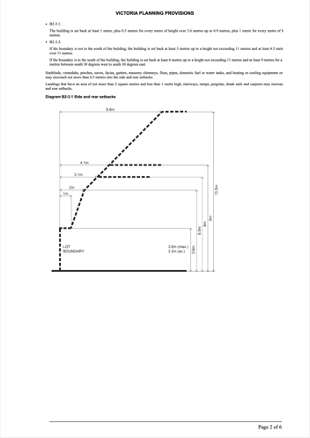
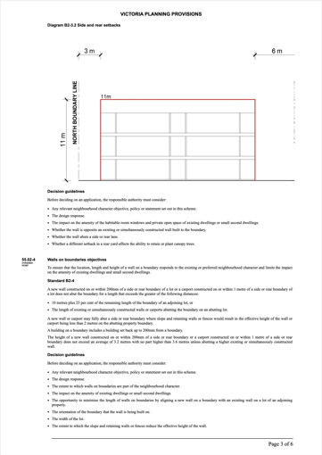
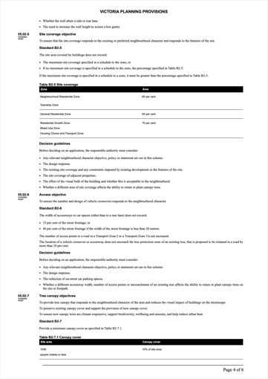
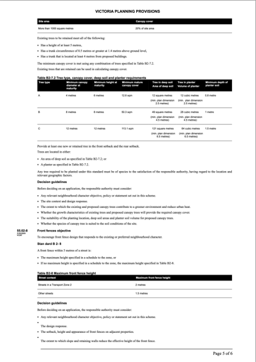
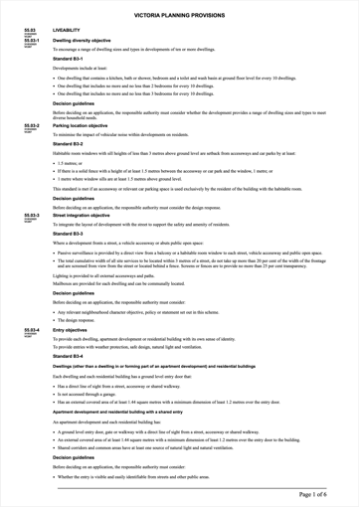
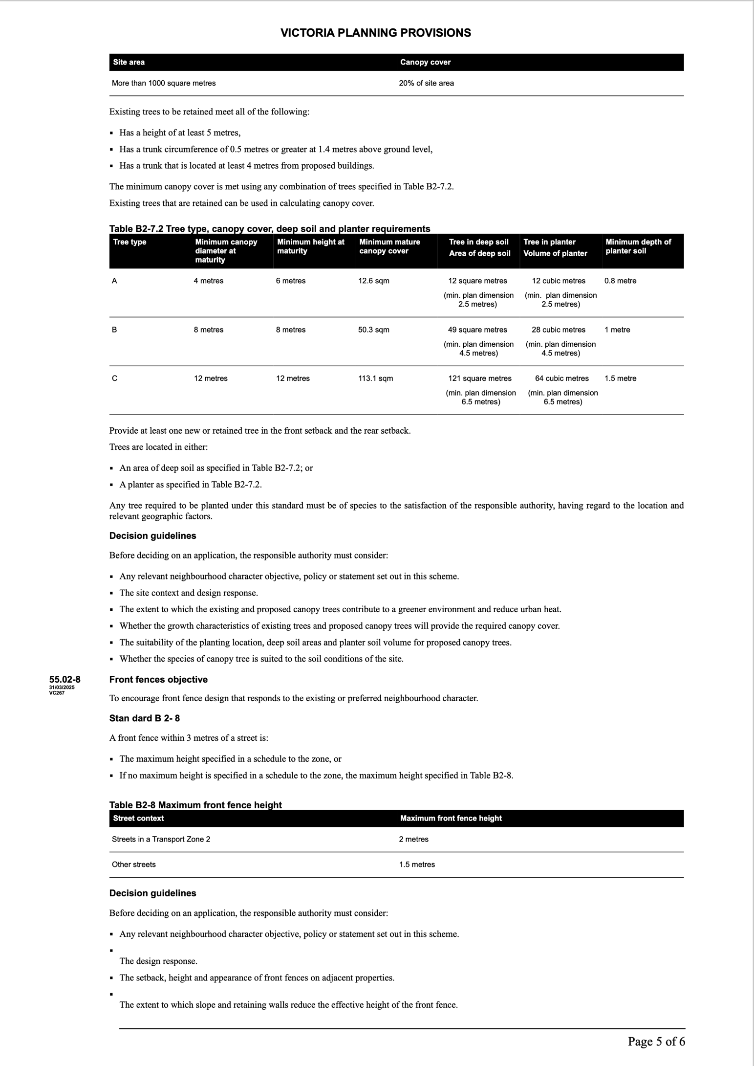
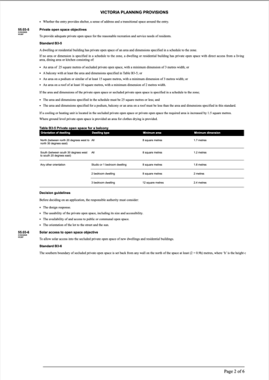
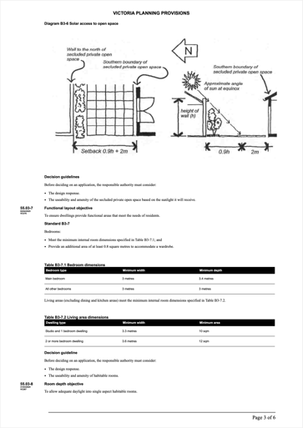
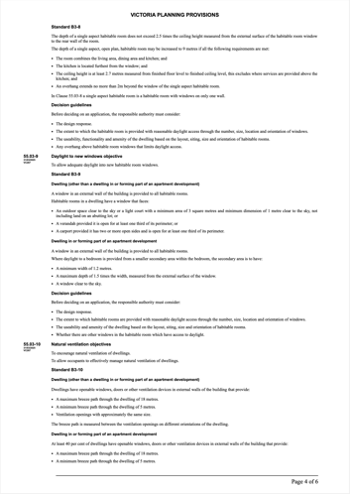
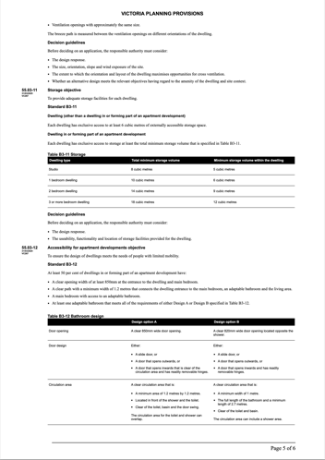
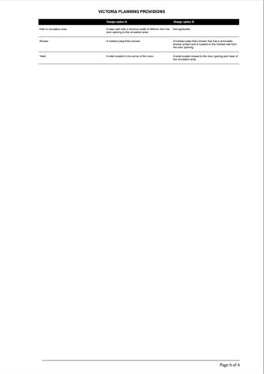
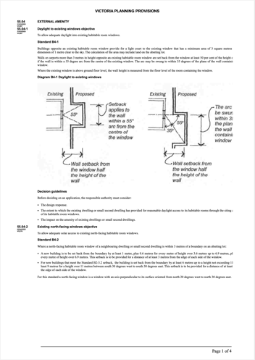
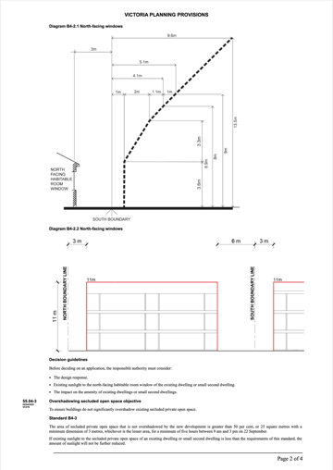
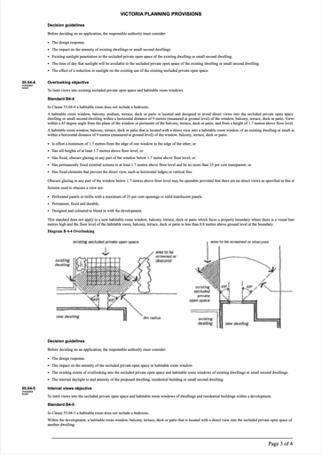
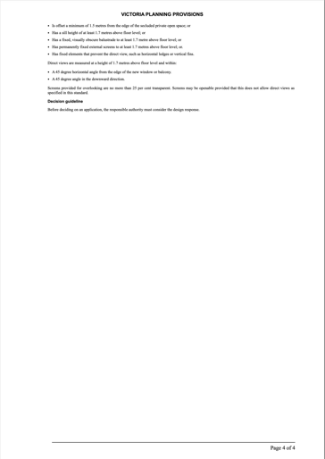
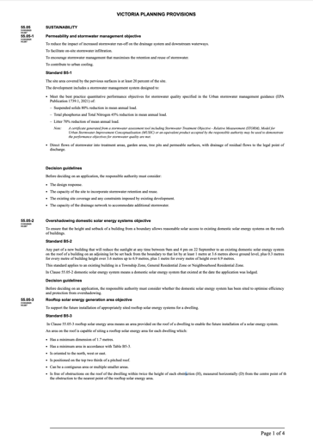
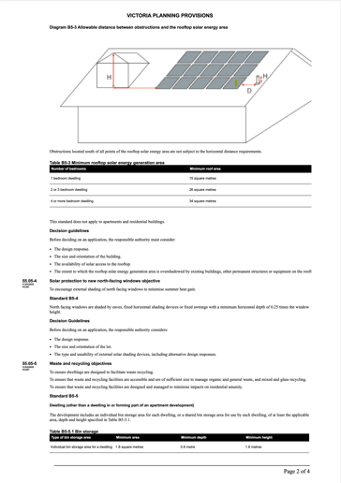
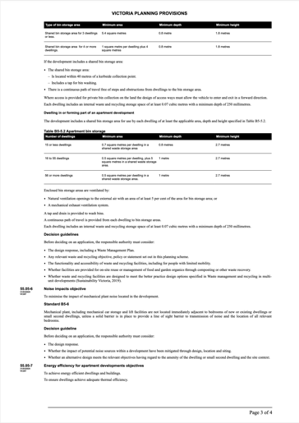
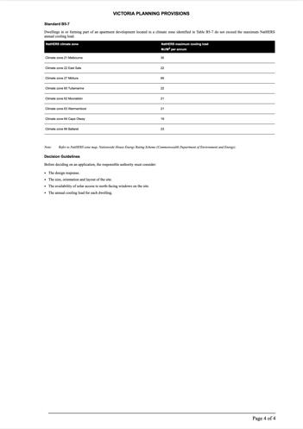
Complexity
Deemed to comply provisions are black-letter law in a way the old code was not. Legal challenges can arise if any error is made.
The provisions are much too complex to be used in this way. This makes promises of system efficiency very dubious.

