Slide 1
Parliamentary Inquiry into Electric Vehicles
Standing Committee on Economy and Infrastructure
Witnesses in attendance at hearing:
Fiona Calvert Paul Salter
Director, Transport Analysis and Assessment Director, Policy and Regulation
13 Feb 2018

Slide 2







A simple, coordinated transport network for Victoria
Transport for Victoria commenced in April 2017 and brings together the planning, coordination and operation of Victoria's transport system and its agencies.
TfV is responsible for planning for the future of Victoria's transport system in support of economic growth and in response to economic, social and environmental challenges posed by population growth.
Technology changes and advancements provide significant opportunities to improve transport outcomes. It is timely for the Parliament and for the community to consider potential benefits, barriers and risks.
Transport for Victoria

Slide 3
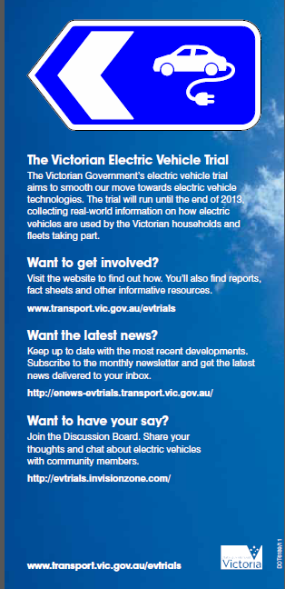
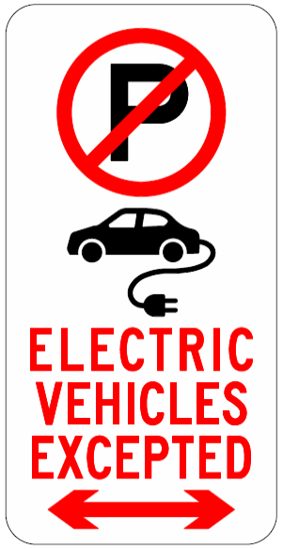
About the Victorian Electric Vehicle Trial: 2010 to 2014
Managed by DTPLI on behalf of the Victorian Government
Multiple partners participated in the trial, including
  Manufacturers – Electricity Industry
  Charging Providers – 80 Fleets esp Local Government
  Insurers – 120 Households
  Universities and TAFEs – 200 Chargers (19 Public)
Only trial in the world at the time to operate with multiple vehicle manufacturers and charging infrastructure providers
CSIRO and RACV were major partners, managing data collection/analysis and recruitment of households, respectively
An advisory steering committee including industry and not-for-profit interest groups helped oversee the trial
Vehicles returned to manufacturers after conclusion
  16 Nissan Leaf
  17 Mitsubishi i-MiEV
  4 Toyota Prius Plug-in Hybrid
  6 retrofitted vehicles

Slide 4
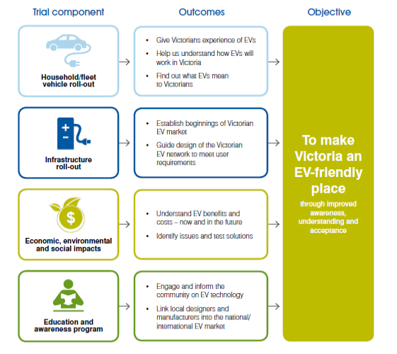
Data collected in the Victorian Electric Vehicle Trial
On-board data acquisition
– Charging time and rate
– Vehicle level of charge
– Energy consumption
– Speed & Heating / A/C usage
– Distance per day and per charge
User surveys
– Prior expectations
– Level of satisfaction with EV
– Travel surveys
– Their priorities in choosing a vehicle

Slide 5
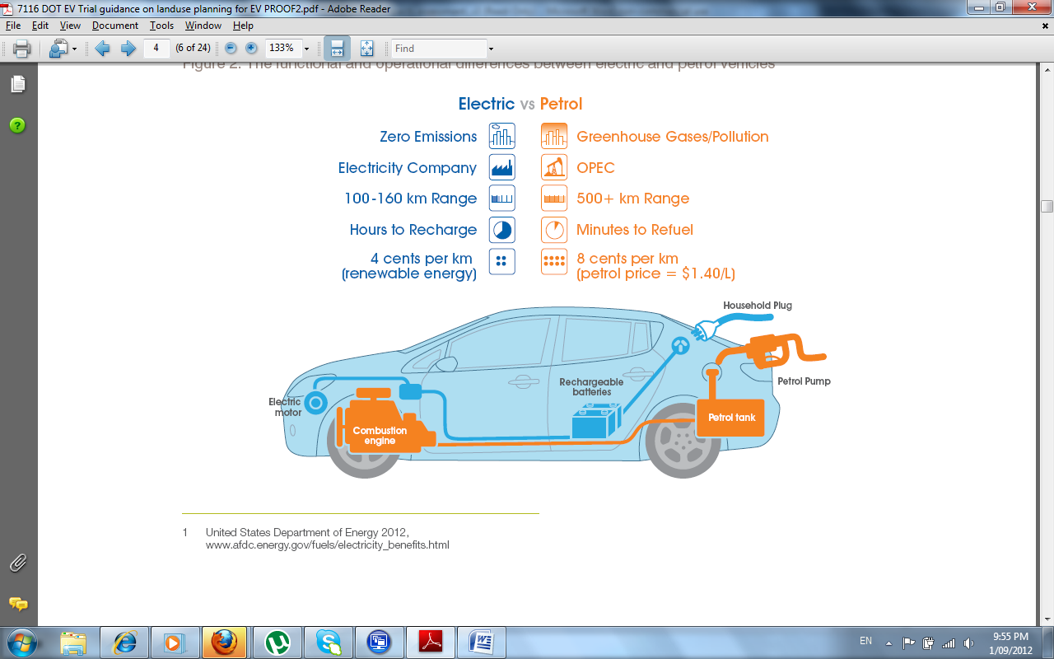
Key things learnt from the Victorian Electric Vehicle Trial
People LOVE driving Electric Vehicles
EVs work as well as Internal Combustion Engine vehicles for most purposes
Range anxiety proved less of a problem than expected once people were exposed to the vehicles (and would be even less of a problem with today’s EVs). Victorian driving patterns are particularly well suited to EVs
In a fleet setting, unfamiliar drivers were wary of using EVs
EVs are likely to provide a significant net benefit to the community in the medium and long term
Notes:
People were apprehensive about range at first, then discovered 120 km was plenty for a normal day’s drive.
Black line is distribution of daily driving distances in Melbourne from VISTA
Salmon colour is distribution of fleet daily distances in Trial based
Green is distribution of household daily distances in Trial based

Slide 6
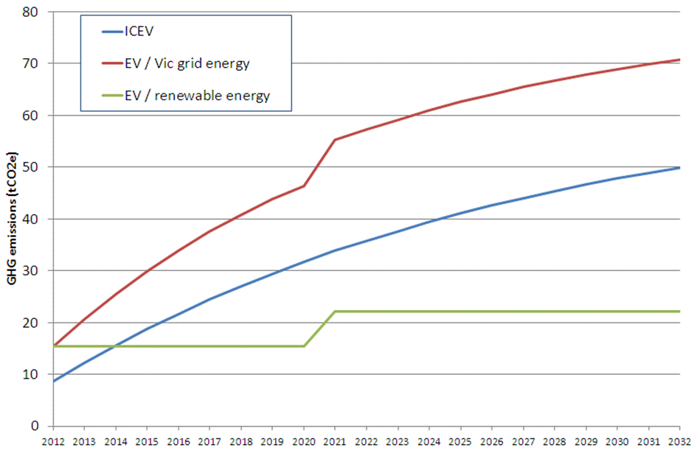
Potential benefits of widespread EV uptake?
Based on reasonable assumptions adopted at the time of the trial, the expectations were that, uptake of EVs would result in:
Improved air quality
Reduced greenhouse emissions
Less noise
Lower running costs
But this depends on a complex interplay of variables and factors:
Energy sources and tipping points for new supply
Consumer behaviours and preferences
Impacts on costs of transport and subsequent demands

Slide 7

Will Greenhouse Gas Savings be realised?
Illustrating the complexities….
Power source
Charging behaviour
Impact on Transport Demand
GHG reduced?
Hydrogen
Cell
Yes
Charge at night
Limited scope to use renewable power at night
Uptake low until more non-solar power available
Renewable energy
Marginal
Charge during day
Cost of power more expensive, impacts on uptake and use
Marginal
Charge during day
Cost of power more expensive, impacts on uptake and use
Marginal
Fossil fuels
Increased base load required
GHG outcome depend on coal versus Petrol/Diesel efficiency
Uncertain
Energy demand within base load
Yes, but for how long ??

Slide 8
Air quality, noise and amenity
Air quality is a major concern in other jurisdictions and this is why European countries and China have ambitious targets for the phasing out of fossil fueled vehicles and the uptake of electric vehicles.
    The air quality imperative is not as strong in Australian cities.
    Air quality problems associated with transport in Australia are linked to the use of diesel by cars and trucks.
    Victorian Governments and officials have consistently raised emission standard issues with the Commonwealth Government.
    TfV continues to believe that there is merit in adopting more stringent standards now.
Electric vehicles produce far less engine noise than do vehicles powered by fossil fuels.
  There will undoubtedly be noise reductions associated with the uptake of electric vehicles.
  However, it needs to be recognised that most road traffic noise is generated by “rubber hitting the road” and this will not change if fossil fuel powered vehicles are replaced by electric vehicles.

Slide 9
Barriers and options to support uptake of electric vehicles
Barriers identified in the trial
Purchase price
Limited range of models available
Limited driving range (now less of a problem)
Incompatibility of vehicle makes/charging infrastructure (resolved as a result of trial in collaboration with Bosch and vehicle manufacturers)
Limited publicly accessible recharging infrastructure
Cost challenges in installing recharging infrastructure (mostly cables) in some residential and fleet settings
Other trial findings
No regulatory barriers to electric vehicles
Economic and commercial benefits can drive uptake
  $1.8b to $23.4b net benefit to Victoria to 2040 depending on purchase prices, oil prices, vehicle supply constraints, public charging infrastructure availability
  Benefits of electric vehicles likely to outweigh costs between 2026 and 2031
Emission and CO2 standards would directly address air quality and greenhouse gas issues

Slide 10
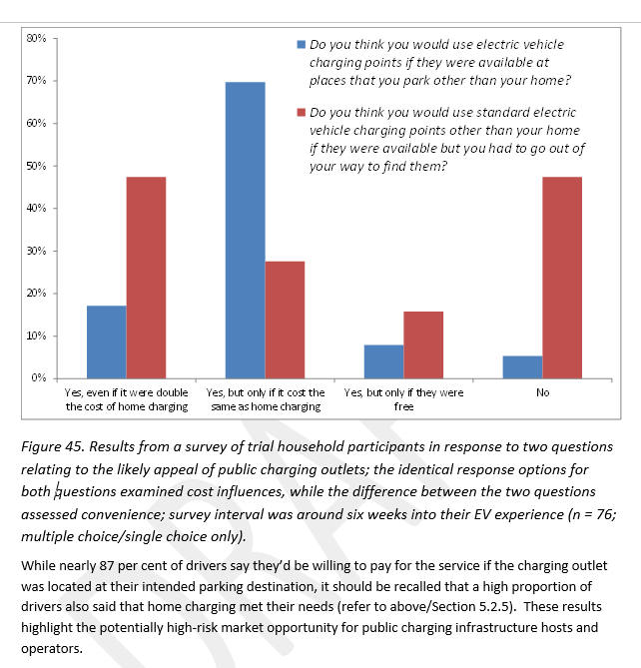
Availability of charging infrastructure
Availability of charging infrastructure may limit early EV take up
Subsidies do not appear to be warranted
  Most charging occurs where the vehicle is parked
  Many people would go out of their way to access a charging point
  Installation costs can be high where cable installation is difficult
Misinformation about charging is a larger potential barrier

Slide 11
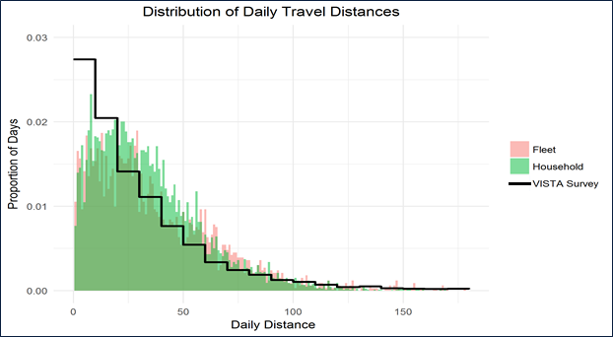
Vehicle range is not a real barrier to take up, but can be perceived as an issue
Only a small percentage of people travel more than 100km a day
Most new generation electric vehicles have a range of 400km or more
The trial found that understanding of range issues was a major factor for unfamiliar drivers of electric vehicles

Slide 12
What is being done now
What Government is doing
$100 discount for registration of EVs
Legal requirement for registration plate identification of EVs from 2019
Supporting the proposed National regulations on vehicle emissions
Notes:
A commonwealth ministerial committee is considering a fleet average limit of 105 g/km GHG emissions, to be phased in by 2025. This will allow industry to “triple count” their EVs when calculating their fleet average emissions. We see this as a powerful driver of vehicle electrification

Slide 13
Electric vehicles in Public transport
Recent initiatives are aimed at shifting the source of electricity powering public transport from coal fired power stations to renewable energy.
    The Government has announced it will run a tender to help build 75MW of new large scale solar farms.
    Around 35MW of the new solar farms will be linked to powering Melbourne’s fleet of over 400 trams.
    This will result in a reduction of more than 80,000 tonnes of greenhouse gas emissions every year.
Electric buses have been bought into service in large numbers in other major cities around the world - particularly China.
    However, their applicability to Melbourne depends on how well vehicle capabilities match to route and cycle requirements.
The Government maintains a high level of influence and control over the replacement of existing buses, the establishment of new bus routes and bringing new buses into service.
    12 of the 13 metropolitan Public transport bus service contracts will expire this year. Early in 2017 the Government announced that it would introduce more flexibility in new replacement contracts.
    The Government announced that it would look at how to introduce smaller and more frequent services and possibly introduce electric buses.

Slide 14
Electric Vehicles in Government Fleets
When there are economic benefits that are able to be obtained then the switch to electric vehicles will occur for public sector fleets.
    However, the vehicles to be purchased also need to be practical for their intended purchase.
    Electric utes have not yet been made available to the market.
    Electric vans that could be used as ambulances etc have not yet been made available.
When the diversity of vehicles that are needed are matched with supply then it will be feasible to make the switch.

Slide 15
Employment Implications and Impacts on Local Manufacturing
Local manufacture:
  Local assembly and fit out would continue for electric buses and trucks
  Victorian Industry Participation Policy likely to apply to bus replacement contracts
    Local content plan
    Additional requirements for high value strategic projects
  Victorian businesses are involved in manufacture of electric vehicle components
  Employment implications:
  TfV has not modelled employment implications
  Likely to be a decline in employment linked to maintenance as electric motors generally require less maintenance
  May be offsetting increases in employment elsewhere in the economy

Slide 16
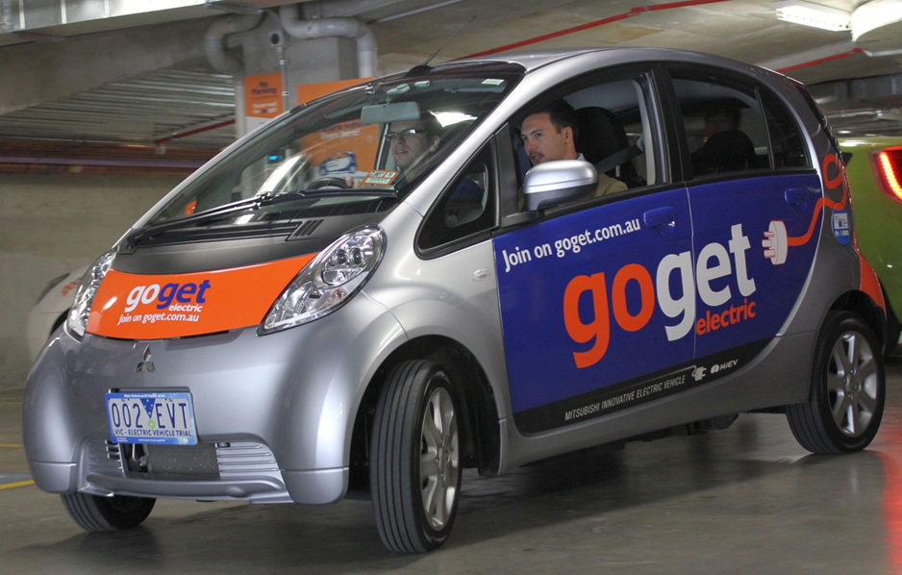
Electric vehicles in car sharing
Electric vehicles well suited to operational demands of customers
GoGet (2011) reported 97 per cent of trips made by their members as being less than 50 kilometres.
Car-sharing also provides a means for the wider community to experience electric vehicle technology first-hand.
GoGet joined the Victorian Electric Vehicle Trial in 2011,

Slide 17
Electric vehicles also well suited to car sharing 2.0
Next generation of car sharing involves the use of road side car spaces with concessions from time limits that normally apply
    Increased logistical challenges
    Found to be feasible in other jurisdictions
Car sharing model likely to have limited lifecycle
    Likely to be overtaken by service offerings that are made possible through automation.
    Automation based on the use of fully electric cars

Slide 18
Future Outlook
Where we see EVs today
Consensus that Electric Cars will be price equivalent to ICE Cars in mid 2020s
Proposed federal emissions regulation will be a powerful driver of EVs if it eventuates
Most major car manufacturers have foreshadowed large scale EV production in the same time frame
Global car industry currently has excess capacity so ICE capacity is likely to scale down
We expect EVs to become mainstream in Victoria over the 2020s
Automation will be built on an EV platform
Cars are consumer goods – subject to vagaries of consumer behaviour
2018
Notes:
Gartner Hype Cycle
Blue is what we expected EVs would go
Red is reality
Trial was at the “Peak of Inflated Expectations”
Now at the Slope of Enlightenment
ICE is internal combustion engine

