Slide 1
Industrial hemp in Victoria
Department of Energy, Environment and Climate Action
September 2023

Slide 2
Notes:
For further information about how to open a meeting with an Acknowledgement of Traditional Owner please see the Welcome to Country and Acknowledgement of Traditional Owners Guidelines. Download or view file.

Slide 3
Agriculture Victoria: Overview
Agriculture Victoria works closely with the agriculture sector and regional communities.
Key areas include:
Maintain effective biosecurity
Support recovery from natural disasters and other challenges
Create and enforce legislation and regulation
Improve animal welfare
Deliver education and compliance services
Enhance productivity, increase resilience and sustainability
Connect with export markets
Support growth and create jobs
Agriculture Victoria also works with industry and research institutions to deliver outcomes for Victorian agriculture.
Agriculture Victoria has a number of roles relevant to industrial hemp:
Legislation and regulation
Research
Industry development

Slide 4
Legislative framework for industrial hemp cultivation
Legislation
Part IVA of the Drugs, Poisons and Controlled Substances Act 1981 - provides for the issuance of authorities for low-THC cannabis
Drugs, Poisons and Controlled Substances (Industrial Hemp) Regulations 2018 - sets fees for authorities and crop inspections
Ministerial responsibilities
Minister for Agriculture has responsibility for Part IVA of the Act
Agriculture Victoria responsibilities
Administers the authority framework and related compliance and communications
Provides associated policy advice to the Minister

Slide 5
Industrial hemp authorities
Industrial hemp authority applications
Fit and proper person test
Confirm proposed activities are for non-therapeutic use (i.e. not for medicinal purposes)
Confirm the proposed location is suitable in regard to security
Application or renewal fee ($477/ $151)
Authority conditions
Notification of planting and proposed harvest date
Record-keeping requirements – seed stocks and supply, annual report
Low level security requirements (locked gate and seed storage areas)
All crops are sampled by Agriculture Victoria to confirm the crop is industrial hemp (low-THC cannabis)
Sampling and laboratory fees apply (average $500 per crop)

Slide 6
Legislation is similar across Australia

Slide 7
Victorian industrial hemp industry
42 authorities in Victoria
6 growers in 2022-23 season – 169 ha
Shift from seed varieties to fibre varieties
Hemp seed approved for food in 2017

Slide 8
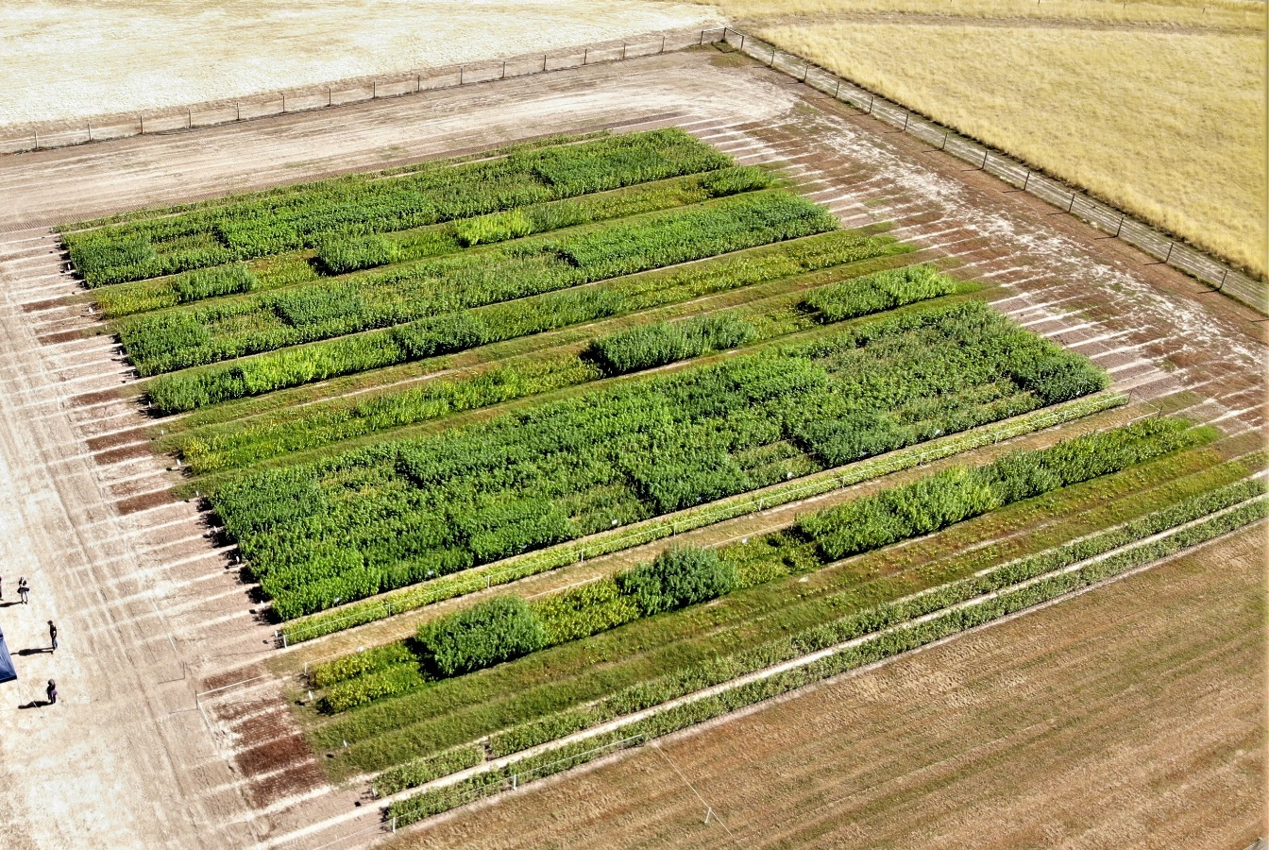
Research
Industrial hemp variety trials (2021-2024) at Hamilton Smart Farm
Researching seed varieties, and some fibre and dual crop varieties
Publish reports and host field days
Best performing varieties achieved grain yields of around 2.5 t/ha in both years
Maximum biomass at final harvest was 10.4 t/ha
Research includes optimum time of sowing, water and fertiliser requirements, and weed control

Slide 9
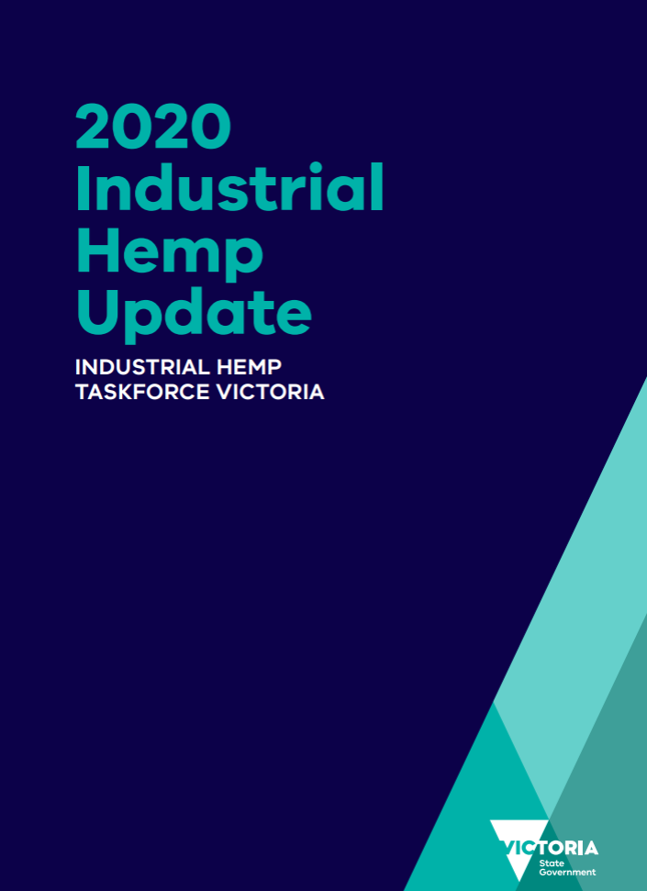
Industrial Hemp Taskforce
Established by the Minister for Agriculture 2019
Agriculture Victoria provided Secretariat function
Taskforce terms of reference included examining information on industry issues, barriers and opportunities, and learnings from other jurisdictions
Interim findings released in 2020, which outlined a number of challenges and opportunities, including harmonisation of regulation with other states (now resolved through legislative amendment)
Industry and government continue to build on the findings of the taskforce to grow the industrial hemp industry in Victoria, such as through the Industrial Hemp Variety Trials

Slide 10
Contacts
Matt Lowe, Deputy Secretary Agriculture Victoria
matt.lowe@agriculture.vic.gov.au
Sarah-Jane McCormack, Executive Director Agriculture Policy and Programs
sarah-jane.mccormack@agriculture.vic.gov.au
Trevor Pisciotta, Executive Director Animal Welfare Victoria and Agriculture Regulatory Policy
trevor.pisciotta@agriculture.vic.gov.au

